Slide 1
Thursday, November 3, 2016
Write In Your Agenda:
Write In Your Monitoring Log:
CW:
Earthquake Quiz
Volcano Word Search and Crossword
Finish Volcano Power Point and Notes
HW:
Finish Volcano Word Search and Crossword (if necessary)
Study for Volcano Quiz on Wednesday, November 9th
Response to Warm-Up:
Describe one new fact you learned from the volcano webquest yesterday.
You will need:
Pencil
Volcanoes note sheet

Slide 2
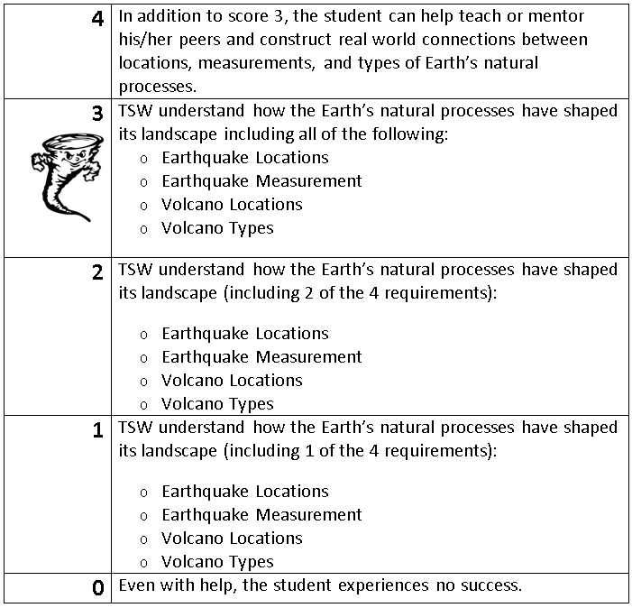
Learning Goal and Scale
TSW understand how the Earth’s natural processes have shaped its landscape (including Earthquake locations and how they are measured as well as Volcano locations and the three types).

